Slide 1
INTRODUCTION
Theory of Computation
王轩
Wang Xuan

Slide 2

Instructor:
王轩 (L1421)
Tel.13760199977
Mail:wangxuan@cs.hitsz.edu.cn
TA:
侯晓涵(L1709)
Tel.13713512806
Mail:toc2020@163.com
QQ Group:1151335383
1

Slide 3
Schedule
2020.08.31 —— 2020.10.28 (week 1-5, 7-9)
13:45-15:30 on Monday(week 1-5, 7-9)
13:45-15:30 on Wednesday (week 1-5, 7-9)
Room A304
2

Slide 4
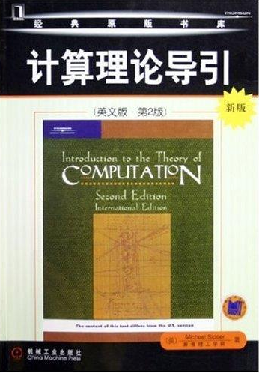
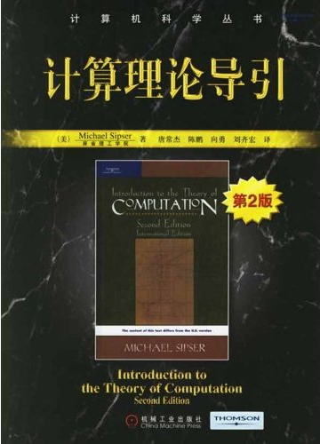
Textbook
计算理论导引(第二版)
唐常杰,陈鹏,向勇,刘齐宏 译,
机械工业出版社
Introduction to the Theory of Computation. Michael Sipser, 2nd edition
3

Slide 5
Addition
Introduction to Automata Theory, Languages, and Computation. John E. Hopcroft, Jeffrey D. Ullman
Elements of the Theory of Computation, 2nd ed. Lewis, Harry R., and Papadimitriou, Christos H.. Prentice-Hall, 1997.
形式语言与自动机理论 蒋宗礼,姜守旭 编著,清华大学出版社
计算复杂性导论 堵丁柱,葛可一,王洁 著,高等教育出版社
4

Slide 6
Grade
Attendance | 8%
Homework | 22%
Projects | 30%
Final Exam | 40%
5

Slide 7
Course description
Theory of computation, as the name implies, is a theory system that uses mathematical tools to analyze and describe the abstract concept 'computation'.
This textbook falls into three parts: automata, computability, complexity. They represent three different aspects of computation: model, limits and cost. Automata describes the problems, solutions and the form of computation mechanism theoretically, and the forms of computation mechanism. Computability focus on the feasibility, Complexity focuses on the cost, that is, the difficulty of solving the problem.
6

Slide 8
Course description
What can we learn?
Why shall we learn this knowledge?
What is a computer?
What can be computed?
What kind of problems is difficult, and what kind of problems are easy?
Those are the fundamental questions of computer science, the subject of computation theory and the subject of this book.
1. All the knowledge is the primordial reality of computer science. As computer science majors, we should have enough understanding about this.
2. They are wonderful, worthy to experience in our life.
3. They are useful in our daily life.
7

Slide 9
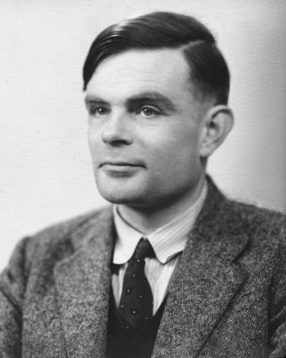
Alan Turing
Turing was highly influential in the development of computer science, giving a formalization of the concepts of "algorithm" and "computation" with the Turing machine, which can be considered a model of a general purpose computer.
Turing is widely considered to be the father of computer science and artificial intelligence.
Alan Mathison Turing
(23 June 1912 – 7 June 1954)
8
Notes:
图灵对于计算机科学的发展有诸多贡献，图灵提出的著名的图灵机模型为现代计算机的逻辑工作方式奠定了基础。他被视为计算机科学之父，人工智能之父

Slide 10
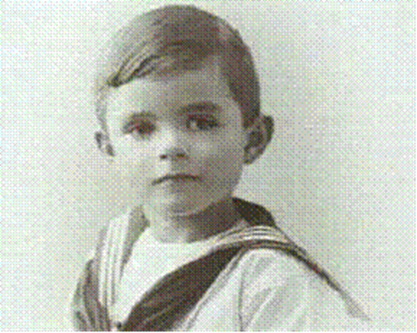
Young Turing
Turing was born in London. Very early in life, Turing showed signs of the genius he was later to display prominently.
In 1928, aged 16, Turing encountered Albert Einstein's work; not only did he grasp it, but he extrapolated Einstein's questioning of Newton's laws of motion from a text in which this was never made explicit.
9
Notes:
图灵出生在伦敦。图灵很小的时候就表现出他的天才，后来就更加显著。
1928年，在图灵16岁的时候，开始阅读阿尔伯特·爱因斯坦的著作。他不但能够理解，而且看出了爱因斯坦对牛顿运动定律存有质疑，即使爱因斯坦的著作中并没有明白指出这点。

Slide 11
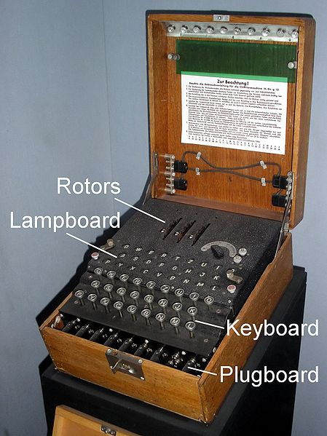
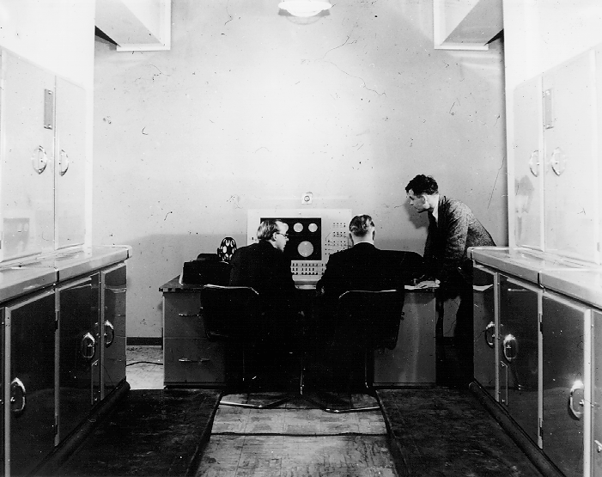
Turing in WW2
During World War II, Turing worked for the Government Code and Cypher School at Bletchley Park, Britain's code breaking center.
He devised a number of techniques for breaking German ciphers, including the method of the bombe, an electromechanical machine that could find settings for the Enigma machine.
Enigma machine
Turing at Bletchley Park
10
Notes:
图灵二战爆发后回到剑桥，后曾协助军方破解德国的著名密码系统Enigma，对盟军取得了二战的胜利有一定的帮助。

Slide 12
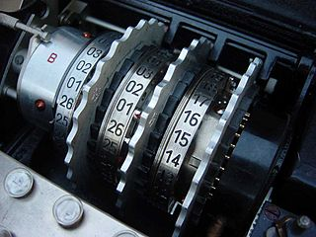
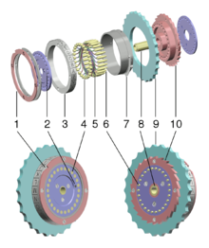
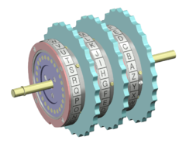
Enigma machine
The early models of enigma machine were used commercially from the early 1920s, and adopted by military and government services of Nazi Germany before and during World War II.
In 1941, British Navy capture an U-110 submarine and get the codebook. Then it was first broken by Bletchley Park, when Alan Turing worked at there.
11

Slide 13
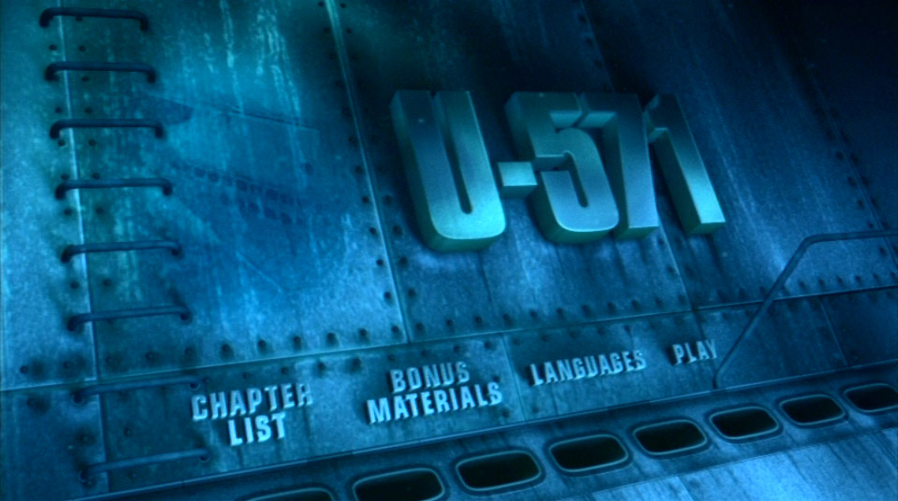
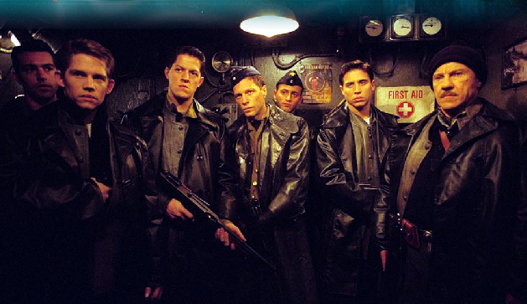
The Film U-571
This film showed the story about getting the codebook of Enigma machine, and then helps Allies win in world war II.
12

Slide 14
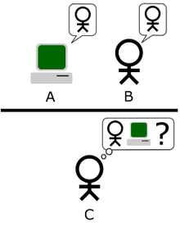
Turing test
Turing wrote an article entitled “Can Machines Think?”, which proposed an experiment which became known as the Turing test, an attempt to define a standard for a machine to be called "intelligent".
13
Notes:
图灵曾写过一篇名为《机器会思考吗？》（Can Machines Think?）的论文，其中提出了一种用于判定机器是否具有智能的试验方法，即图灵测试。

Slide 15
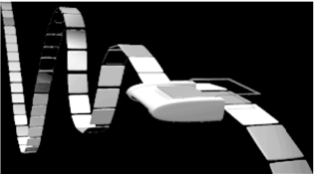
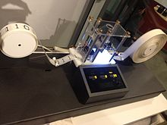
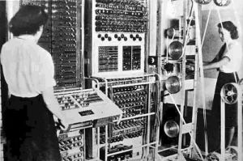
Turing machine
A Turing machine is a hypothetical device that manipulates symbols on a strip of tape according to a table of rules.
It was invented in 1936 by Alan Turing who called it an "a-machine" .
14
Notes:
是英国数学家阿兰·图灵于1936年提出的一种抽象计算模型，其更抽象的意义为一种数学逻辑机，可以看作等价于任何有限逻辑数学过程的终极强大逻辑机器。

Slide 16
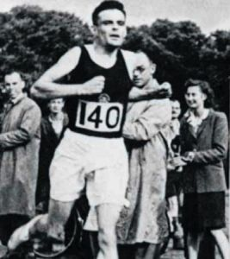
Alan Turing
Turing was a talented long-distance runner. His best result in marathon was 2 hours 46 minutes 3 ​​seconds.
While working at Bletchley, Turing occasionally ran the 40 miles to London when he was needed for high-level meetings, and he was capable of world-class marathon standards.
15
Notes:
图灵还是一位世界级的长跑运动员。他的马拉松最好成绩是2小时46分3秒。

Slide 17
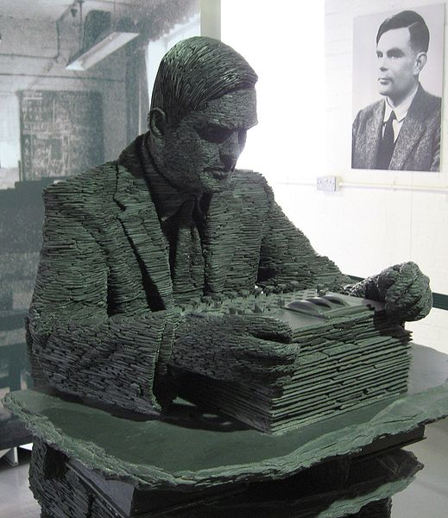
Alan Turing
Turing's homosexuality resulted in a criminal prosecution in 1952, when homosexual acts were still illegal in the United Kingdom. He died in 1954, just over two weeks before his 42nd birthday, from cyanide poisoning.
On 10 September 2009, following an Internet campaign, British Prime Minister Gordon Brown made an official public apology on behalf of the British government for "the appalling way he was treated."
16
Notes:
因为图灵的同性恋倾向而遭到的迫害使得他的职业生涯尽毁。在2009年9月10日，一份超过3万人的请愿签名，使英国首相戈登·布朗在《每日电讯报》撰文，因为英国政府当年以同性恋相关罪名起诉图灵并定罪，导致他自杀身亡，正式向艾伦·图灵公开道歉。

Slide 18
Turing machine equivalence
λ-calculus
Register machine
Markov algorithm
Computable function
17
Notes:
寄存器机 马尔可夫算法 λ演算 递归函数(可计算性函数)
这些模型无一例外地都和图灵机的计算能力等价，因此邱奇，图灵和哥德尔 提出了著名的邱奇-图灵论题：一切直觉上能计算的函数都可用图灵机计算，反之亦然。

Slide 19
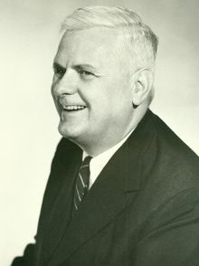
λ-calculus
Lambda calculus is a formal system in mathematical logic and computer science for expressing computation by way of variable binding and substitution. It was first formulated by Alonzo Church.
Lambda calculus has played an important role in the development of the theory of programming languages, including Lisp, ML, Haskell, etc.
Alonzo Church was an American mathematician and logician who made major contributions to mathematical logic and the foundations of theoretical computer science.
Alonzo Church
18

Slide 20
Register machine
Historical development of the register machine model
1 (1954, 1957) Wang's model: Post-Turing machine
2 Minsky, Melzak-Lambek and Shepherdson-Sturgis models "cut the tape" into many
3 (1961) Melzak's model is different: clumps of pebbles go into and out of holes
4 Lambek (1961) atomizes Melzak's model into the Minsky (1961) model: INC and DEC-with-test
5 Elgot-Robinson (1964) and the problem of the RASP without indirect addressing
6 Hartmanis (1971)
7 Cook and Reckhow (1973) describe the RAM
19

Slide 21
Markov algorithm
Markov algorithms are named after the mathematician Andrey Markov, Jr.
Andrey Andreyevich Markov Jr. was a Soviet mathematician, the son of the Russian mathematician Andrey Andreyevich Markov Sr, and one of the key founders of the Russian school of constructive mathematics and logic.
Refal is a programming language based on Markov algorithms.
20

Slide 22
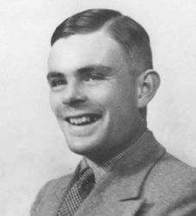
Church-Turing Thesis
In 1936, Turing used his model Turing machine to proved his mind. But Church had proposed a similar thought several months earlier, within λ calculus and Computable function. Soon, under Church’s help, Turing found that all these models are computationally equivalent to the Turing machine. Such models are said to be Turing complete.
The Church–Turing thesis states that a function is algorithmically computable if and only if it is computable by a Turing machine.
21

Slide 23
Universal Turing Machine
In computer science, a universal Turing machine (UTM) is a Turing machine that can simulate an arbitrary Turing machine on arbitrary input. Alan Turing introduced this machine in 1936–1937.
A universal Turing machine can calculate any recursive function, decide any recursive language, and accept any recursively enumerable language.
According to the Church-Turing thesis, the problems solvable by a universal Turing machine are exactly those problems solvable by an algorithm or an effective method of computation, for any reasonable definition of those terms.
22
Notes:
通用图灵机（Universal Computing Machine，又称Machine U）是一种图灵机，由艾伦·图灵在1936年发明。这种多用途单机器（计算机器）模型可以“运行”任何任意（但well-formed）指令序列（称为 "quintuples"）。

Slide 24
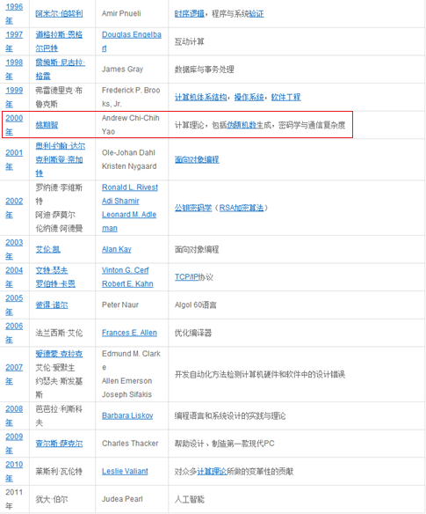
Turing Award
The ACM A.M. Turing Award is an annual prize given by the Association for Computing Machinery (ACM) to "an individual selected for contributions of a technical nature made to the computing community".
23
Notes:
图灵奖是计算机协会（ACM）于1966年设立的，又叫“A.M. 图灵奖”，专门奖励那些对计算机事业作出重要贡献的个人。

Slide 25
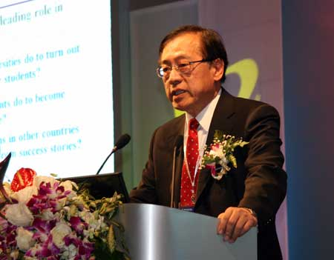
Andrew Chi-Chih Yao
Andrew Yao received the Turing Award, the most prestigious award in computer science, in 2000, "in recognition of his fundamental contributions to the theory of computation, including the complexity-based theory of pseudorandom number generation, cryptography, and communication complexity".
Turing Award in 2000
24
Notes:
2000年，因为姚期智对计算理论，包括伪随机数生成，密码学与通信复杂性的诸多贡献，美国计算机协会（ACM）授予他该年度的图灵奖。

Slide 26
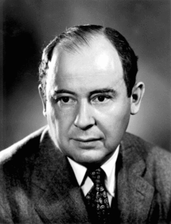
John von Neumann
John von Neumann was a Hungarian-born American pure and applied mathematician and polymath. He made major contributions to a number of fields,including mathematics , physics, economics , computer science, and statistics.
John von Neumann consulted for the ENIAC project, when ENIAC was being modified to contain a stored program. Since the modified ENIAC was fully functional by 1948 and the EDVAC wasn't delivered to Ballistics Research Laboratory until 1949, one could argue that ENIAC was the first computer to use a stored program.
Von Neumann in the 1940s
25
Notes:
约翰·冯·诺伊曼，出生于匈牙利的美国籍犹太人数学家，现代计算机创始人之一。他在计算机科学、经济、物理学中的量子力学及几乎所有数学领域都作过重大贡献
1945年6月，冯·诺伊曼与戈德斯坦、勃克斯等人，联名发表了一篇长达101页纸的报告，即计算机史上著名的“101页报告”，是现代计算机科学发展里程碑式的文献。明确规定用二进制替代十进制运算，并将计算机分成五大组件，这一卓越的思想为电子计算机的逻辑结构设计奠定了基础，已成为计算机设计的基本原则。1951年，EDVAC计算机宣告完成。由于他在计算机逻辑结构设计上的伟大贡献，他被誉为“计算机之父”。

Slide 27
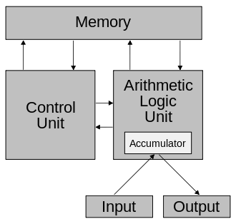
von Neumann architecture
The term Von Neumann architecture derives from a 1945 computer architecture description by the mathematician and early computer scientist John von Neumann and others, First Draft of a Report on the EDVAC.
This architecture is a Physical device of Universal Turing Machine.
26

Slide 28
Course Description
Introduction
Automata and Languages
Context-Free Languages
The Church-Turing Thesis
Decidability
Reducibility
Time Complexity
27

Slide 29
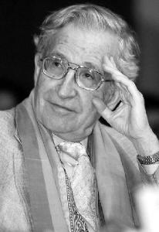
Noam Chomsky
Avram Noam Chomsky is an American linguist, philosopher, cognitive scientist, logician, and political commentator and activist. Working for most of his life at the Massachusetts Institute of Technology (MIT), where he is currently Professor Emeritus, he has authored over 100 books on various subjects.
Chomskyan linguistics, challenges structural linguistics and introduces transformational grammar. This approach takes sequences of words to have a syntax characterized by a formal grammar; in particular, a context-free grammar extended with transformational rules.
28

Slide 30
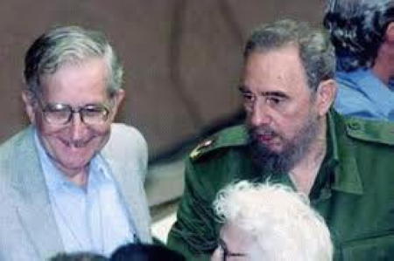
Noam Chomsky
Chomsky is also well known as a political activist, and a leading critic of U.S. foreign policy, state capitalism, and the mainstream news media. Ideologically, he aligns himself with anarcho-syndicalism and libertarian socialism.
29
Notes:
乔姆斯基还因他对政治的热忱而著名，尤其是他对美国和其它国家政府的批评。从1960年评论越南战争以来，他的媒体和政治评论便越来越著名。一般认为他是活跃在美国政坛左派的主要知识分子。乔姆斯基把自己归为自由意志社会主义者，并且是无政府工团主义的同情者。

Slide 31
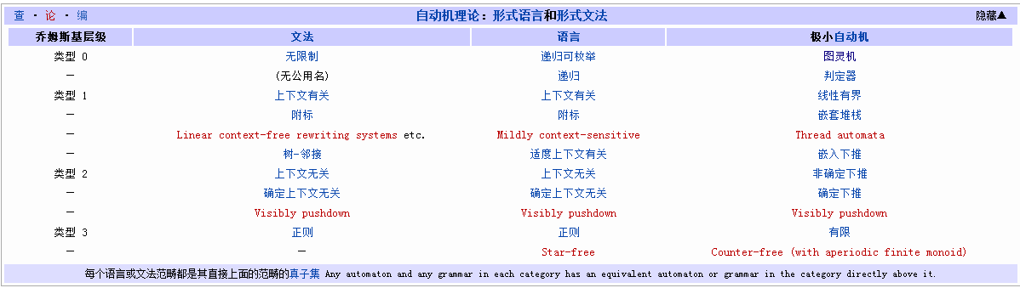
Chomsky hierarchy
The Chomsky Hierarchy allows the possibility of a computer science model to accomplish meaningful linguistic goals systematically. Different kind of languages can be recognized by different kind of automatons.
The following table summarizes each of Chomsky's four types of grammars, the class of language it generates, the type of automaton that recognizes it, and the form its rules must have.
30

Slide 32
Reducibility
A quick way of solving the new problem is to transform each instance of the new problem into instances of the old problem
Another, more subtle use is this: if we can show that every instance of the old problem can be solved easily by transforming it into instances of the new problem and solving those, we have a contradiction. This establishes that the new problem is also hard.
In Cryptography reducibility is used a lot to prove the cipher is secure.
31
Notes:
我们解题时常遇见似曾相识的题目。此时，我们若可将新题转换成已解旧题的一例，则新题亦解矣。
另一更微妙的用法是：若我们拥有一个已证明难以解决的问题，我们又获得另一个相似的新问题。我们可合理推想此新问题亦是难以解决的。我们可由下列谬证法得证：若此新问题本质上容易解答，且若我们可展示每个旧问题的实例可经由一系列转换步骤变成新问题的实例，则旧问题便容易解决，因此得到悖论。因此新问题可知亦难以解决。

Slide 33
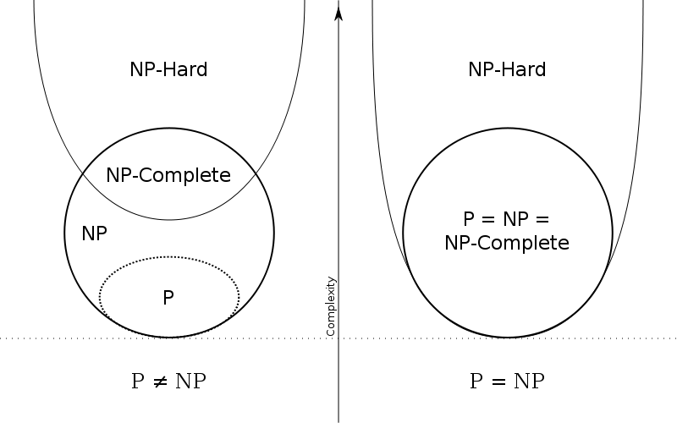
P versus NP
The Millennium Prize Problems are seven problems in mathematics that were stated by the Clay Mathematics Institute in 2000. As of July 2013, six of the problems remain unsolved. A correct solution to any of the problems results in a US$1,000,000 prize being awarded by the institute.
The Millennium Prize Problems:
1. P versus NP
2. The Hodge conjecture
3. The Poincaré conjecture (proven)
4. The Riemann hypothesis
5. Yang–Mills existence and mass gap
6. Navier–Stokes existence and smoothness
7. The Birch and Swinnerton-Dyer conjecture
32
Notes:
千禧难题：2000年5月24日，美国Clay数学研究所(Clay Mathematics Institute) 在巴黎法兰西学院提出了“21世纪七大数学难题”，他们对每个问题悬赏一百万美元。它们是21世纪最有意思和最具挑战性的问题。

Slide 34
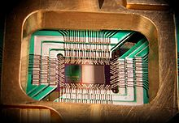
Quantum computers
A quantum computer is a computation device that makes direct use of quantum-mechanical phenomena, such as superposition and entanglement, to perform operations on data.
Large-scale quantum computers will be able to solve certain problems much more quickly.
But it does not violate the Church–Turing thesis.
In 2011, D-Wave Systems announced the first commercial quantum annealer on the market by the name D-Wave One.
Photograph of a chip in D-Wave One
33
Notes:
一个量子图灵机(quantum Turing machine，QTM), 或者通用量子计算机(universal quantum computer)，是一个表示量子电脑能力的抽象机器。量子图灵机使用一个简单的模型来展示量子计算的能力。1985年，牛津大学的D. Deutsch提出量子图灵机（quantum Turing machine）的概念。

Slide 35
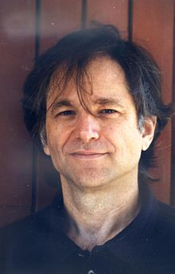
DNA computing
DNA computing was initially developed by Leonard Adleman of the University of Southern California, in 1994.
Adleman demonstrated a proof-of-concept use of DNA as a form of computation which solved the seven-point Hamiltonian path problem.
Since the initial Adleman experiments, advances have been made and various Turing machines have been proven to be constructible.
34
Leonard Max Adleman

Slide 36
THE END
Thank you!!

